Slide 1

CS491- 492 Progress Meeting 1
Fennec Radio

Slide 2
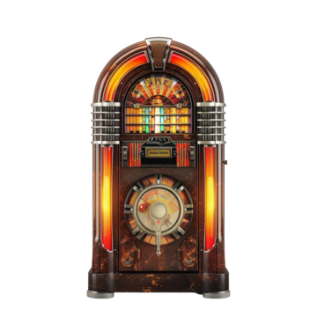
Table of Contents
1. Introduction
2. Team
3. Problem
4. Solution
5. Competition
6. Market Opportunity
7. Business Model
8. Go-to-Market Strategy
9. Roadmap
10. Call to Action + End

Slide 3

Introduction
Welcome to the future of radio! Imagine a radio platform where anyone can become a broadcaster.
Fennec empowers users to become broadcasters, host live shows, and even interact with listeners in real time with live-chats or joining the broadcast in real time.
Furthermore, with AI-powered DJs that can adapt playlists and engage through interactive polls and events, the platform offers a personalized experience for every listener. Whether it's live chats, listener participation, or AI-driven content.
We’re transforming traditional radio into a dynamic, engaging, and interactive digital space.

Slide 4
Team
Developers
Süleyman Yağız Başaran
Hikmet Kaan Oktay
Bartu Özyıldırım
Emir Feza Çelik
Atakan Keser
Supervisor and Innovation Expert
Özgür Ulusoy
Ali C. Beğen

Slide 5
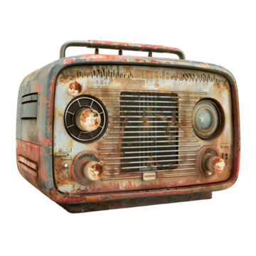
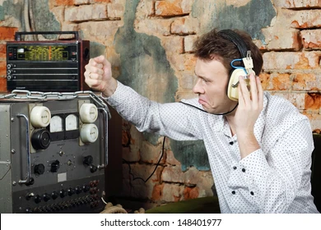
Problem
Traditional radio is static, one-way, and lacks personalization.
Listeners have limited control over what they hear.
Content creators face barriers to entry, such as high costs and complex broadcasting technology. Need to apply for radio companies and meet the high requirements.
In a world where audiences crave interactivity, customization, and real-time engagement, radio
is struggling to keep up with modern user expectations. Therefore, Fennec enters the party.
There's a need for a platform that allows users to both broadcast and listen, while incorporating,
popular and advanced technology like AI to create an interactive, personalized radio experience.

Slide 6
Solution
+ Features
User-Generated Broadcasts Any user can easily create and host their own live radio shows, removing traditional barriers to entry. No third-party softwares are needed like OBS.
Interactive Listener Engagement Real-time chat, polls, and listener participation options allow hosts and audiences to connect and talk during broadcasts.
AI-Powered DJs AI-driven broadcasters deliver personalized music, news, and content, adapting to listener preferences and moods. AI DJs can alter playlists based on real-time feedback, polls, and listener moods, offering a more engaging experience (Still indefinite about custom AI for every user or specific and less AIs for differrent groups).
Chat Rooms
Public places where people can talk with each other.

Slide 7


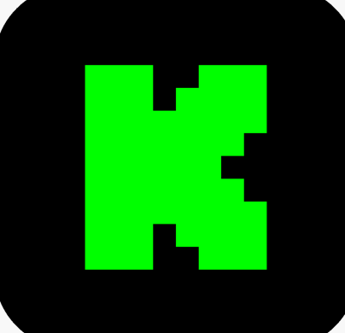
Competition
However, we are aware of the fact that radio is not our main competition as it is already losing interest, we are trying to modernize radio and revive it. Our main competitions are live broadcasting platforms.
Twitch
Kick
Youtube
Tiktok
Instagram
Twitter
Main competitors
Potential competitors

Slide 8








Competition
Additionally, there are smaller live-video platforms that still compete with these whales. We want start small then move forward. All the below statistics are monthly (https://streamscharts.com/platforms).
NimoTV: 60569 viewers, 300 live channels, %84 Vietnamese
Trovo: 8457 viewers, 497 live channels, %83 Russian
Rumble: 25507 viewers, 214 live channels, mostly English
Bigo LIVE: 1345 viewers, 91 live channels, mostly English
AfreecaTV: 48529 viewers, 1080 live channels, %100 Korean
Naver’s CHZZK: 125 925 viewers, 4041 live channels, %100 Korean
SOOP: 3808 viewers, 50 live channels, %92 Thai
SteamTV: 34765 viewers, 213 live channels, %100 English

Slide 9
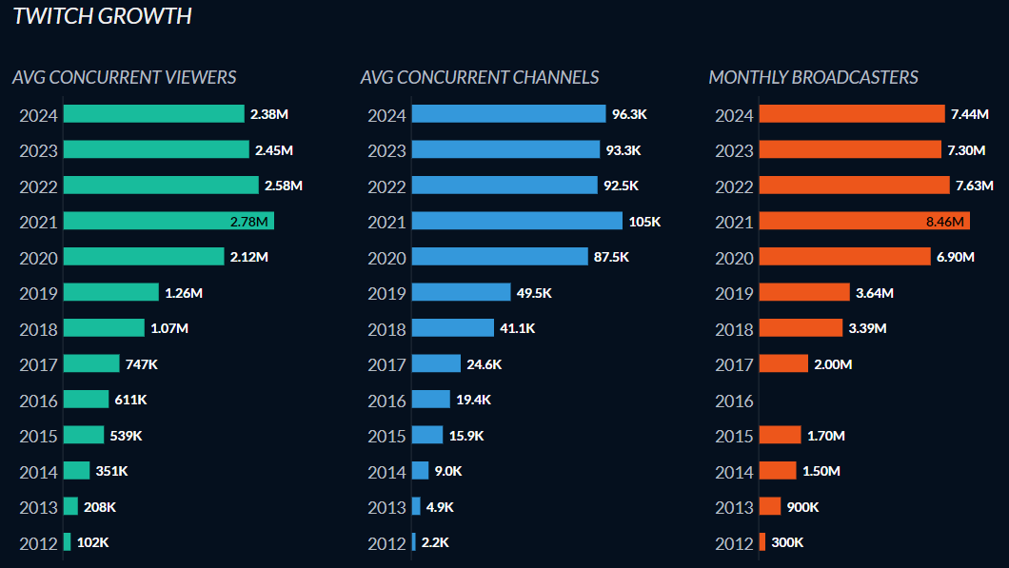
Market Opportunity
Global
(https://twitchtracker.com/statistics)

Slide 10
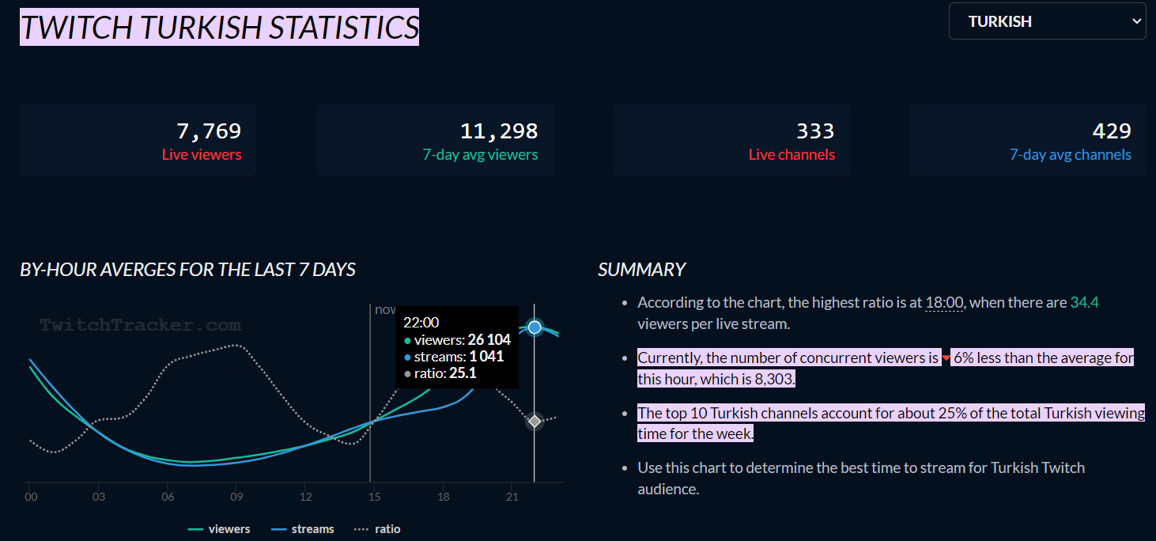
Market Opportunity
https://twitchtracker.com/languages/Turkish.

Slide 11
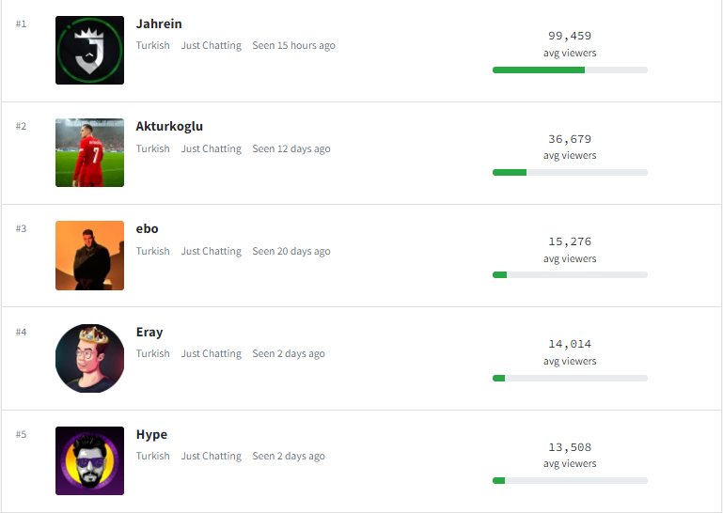
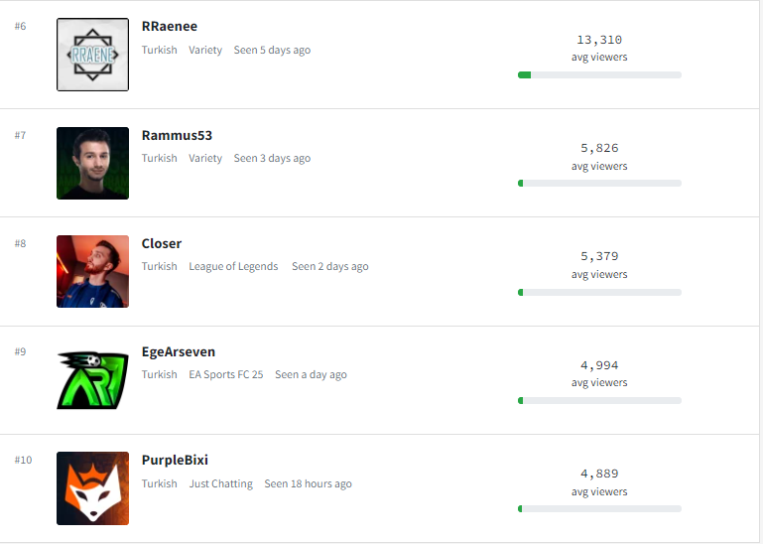
Market Opportunity
October 2024 (https://www.twitchmetrics.net/kick_channels/popularity?lang=Turkish)

Slide 12
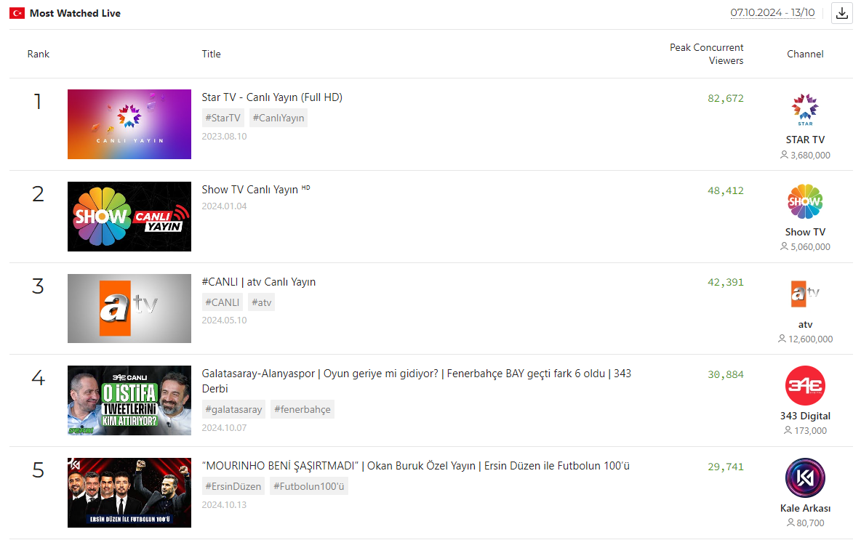
Market Opportunity
Weekly Youtube Live TR
(https://playboard.co/en/chart/live/most-watched-all-videos-in-turkey-weekly)

Slide 13
Market Opportunity !
More Americans listen to the radio than use Facebook each week.
55% of Gen Z in the U.S. listen to AM/FM radio every day.
Adults listen to 104 minutes of radio per day, 12.2 hours per week.
Radio industry sees growth through smart speakers and online listening.
100 million Americans own a smart speaker.
Radio holds the highest share of collective trust across all advertising channels.
77% of listeners would try a brand or product endorsed by their favorite radio personality.
It takes 2.4 days on average for audio ad listeners to take an action.
Global radio ad spend is a $36.1 billion a year market.
(https://musicalpursuits.com/radio/)

Slide 14
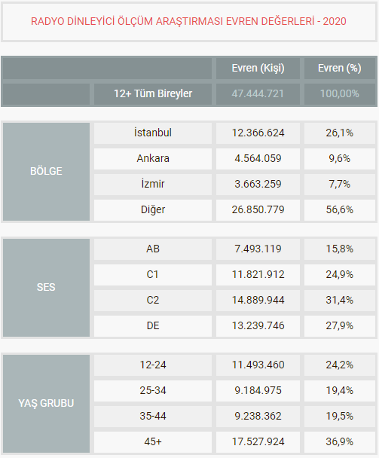
Market Opportunity !!
Radio is still a very largely used tool in Turkiye.
Our advantage is, we are not only focusing on the younger generations but also the older generations which still has a big market potential with the most listeners. All thanks to name: Radio.
It is an old technology at the end of the day and we are mixing it with the recent technologies like streaming.
Therefore, we believe that this project is innovative and has lots of potential.
https://riak.com.tr/evren-degerleri

Slide 15

Business Model
Individuals: Freemium
Donating or subscribing with a price is going to be possible for your favorite streamer.
A radio classic; small ad breaks is also profitable as they have the perfect ratio for price/performance amond other media organs.

Slide 16
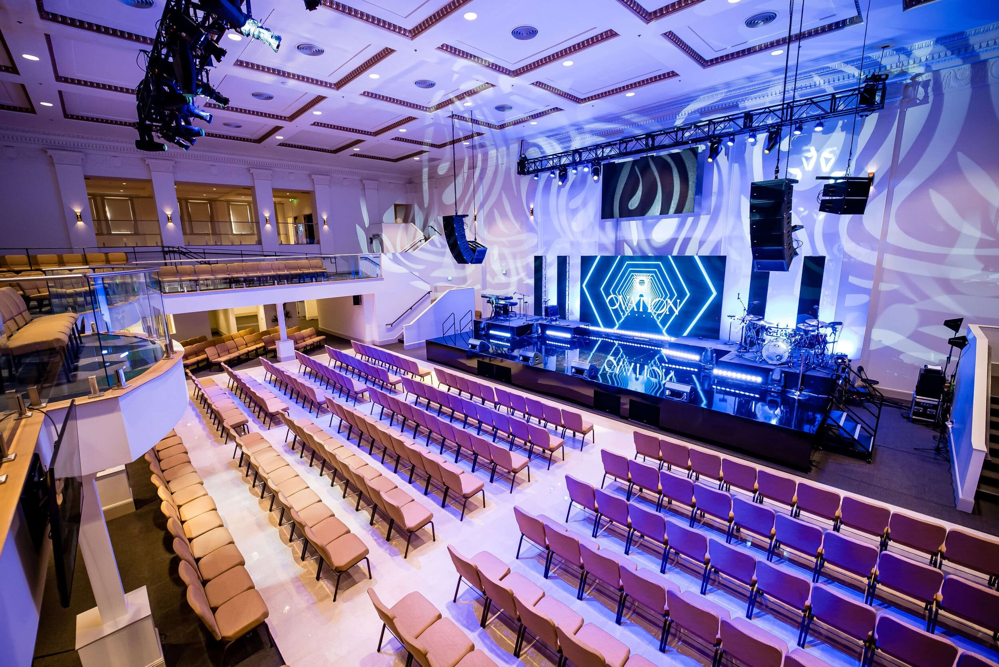
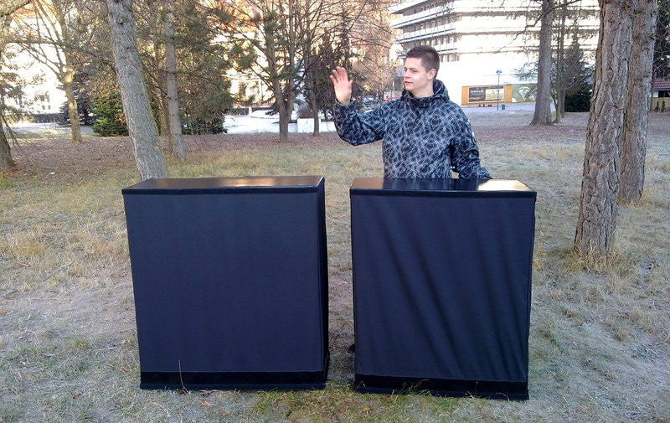
Go-to Market Strategy
Acquire customers by social media, direct contact, content marketing, making events and giving prizes in the school, conferences etc.
Giving ads to traditional radios.

Slide 17
Roadmap
Make further analysis and diagrams. Write wanted reports.
Make the demo until the end of Fall 2025.
Make full product and be ready to launch until the end of Spring 2025.
Be ready for the next big step in the summer and future.

Slide 18
End
Thank you for your time and thanks for listening/reading ☺
We are just looking for trust in the project from our advisors and professors.
And maybe student credits from companies.

